Slide 1
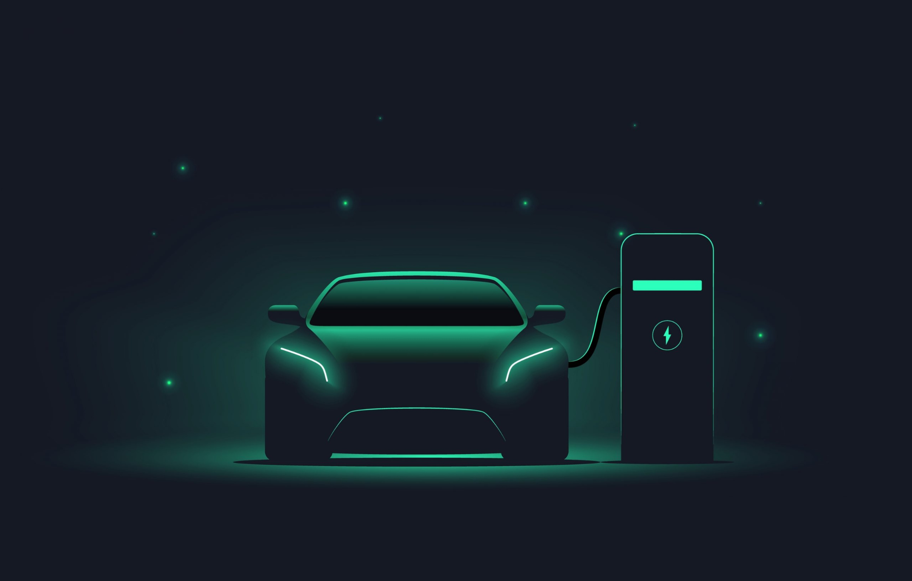
Seminar
Electric Vehicle and charging methods of EV.
By Nikhil Ambigar

Slide 2
Contents:
What is electric vehicle.
Types of electric vehicles.
Battery Electric Vehicles(BEVs).
Hybrid Electric Vehicles(HEVs).
Plug-in Hybrid Electric Vehicles(PHEVs).
Motivation to embrace EVs.
Interesting Facts about EVs.
Electric Vs Gasoline.
Parts of Electric Vehicle.
How does it work.?
Charging methods of EVs.
Trickle charge.
AC charge.
DC charge.

Slide 3

What is Electric Vehicle..?
EVs are vehicles that are either partially or fully powered on electric power.
Unlike vehicles with combustion engines, electric vehicles do not produce exhaust gases during operation. This alone makes electric vehicles more environmentally friendly than vehicles with conventional technology.
There are three types of Electric vehicles and they are as follows:
1.Battery electric vehicle(BEV).
2.Hybrid Electric vehicles (HEVs).
3.Plug-in Hybrid Electric Vehicles (PHEV).

Slide 4
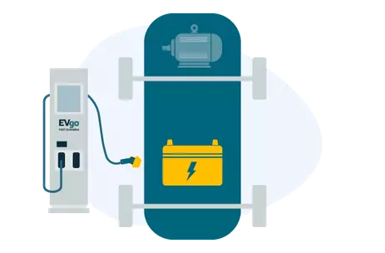
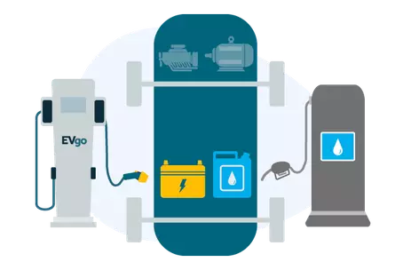
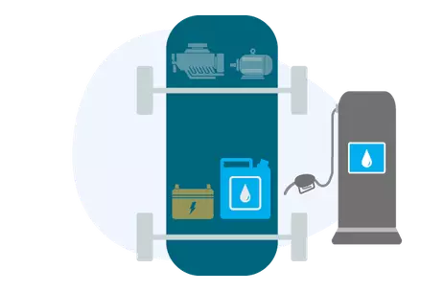
Types of Electric Vehicles:
Battery Electric Vehicles (BEVs) Plug-in Hybrid Electric Vehicles (PHEVs) Hybrid Electric Vehicles (HEVs)
Powered solely by an electric battery, with no gas engine parts. Most BEVs are capable of fast charging and L2 charging.
Similar to a Hybrid, but with a larger battery and electric motor. Has a gas tank and a charging port. Can charge by using L2 chargers.
Low-emission vehicles that use an electric motor to assist gas-powered engines. All energy comes from gasoline. Cannot charge with EVgo.

Slide 5
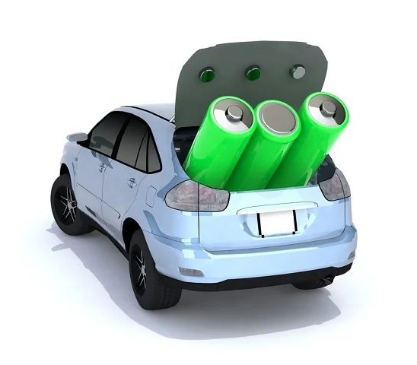
Battery Electric Vehicles (BEV):
BEVs are fully electric vehicles with rechargeable batteries and no gasoline engine. All energy to run the vehicle comes from the battery pack which can be recharged from the EVgo.
Advantages of BEV’s :
Creates very little noise.
No exhaust, no spark-plugs.
No clutch or gear.
Doesn’t burn fossil fuels, instead use rechargeable batteries.
BEVs can be charged at home overnight, providing enough range for average journeys.

Slide 6
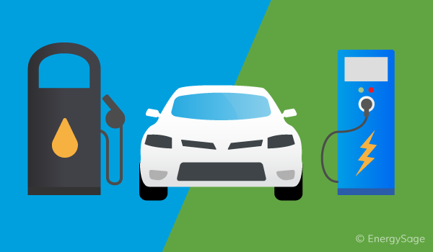
Hybrid Electric Vehicles (HEVs):
Hybrid Electric Vehicles, or HEVs, have both a gas-powered engine and an electric motor to drive the car. The engine and the motor simultaneously turn the transmission which power the wheels. The HEVs cannot be recharged from the power grid.
Advantages of BEV’s :
Can reduce our use of fossil fuels.
You can save money on gasoline.
Hybrid car can help to slow down the global warming.
Help us to protect our natural resources.
Energy can be used efficiently.

Slide 7
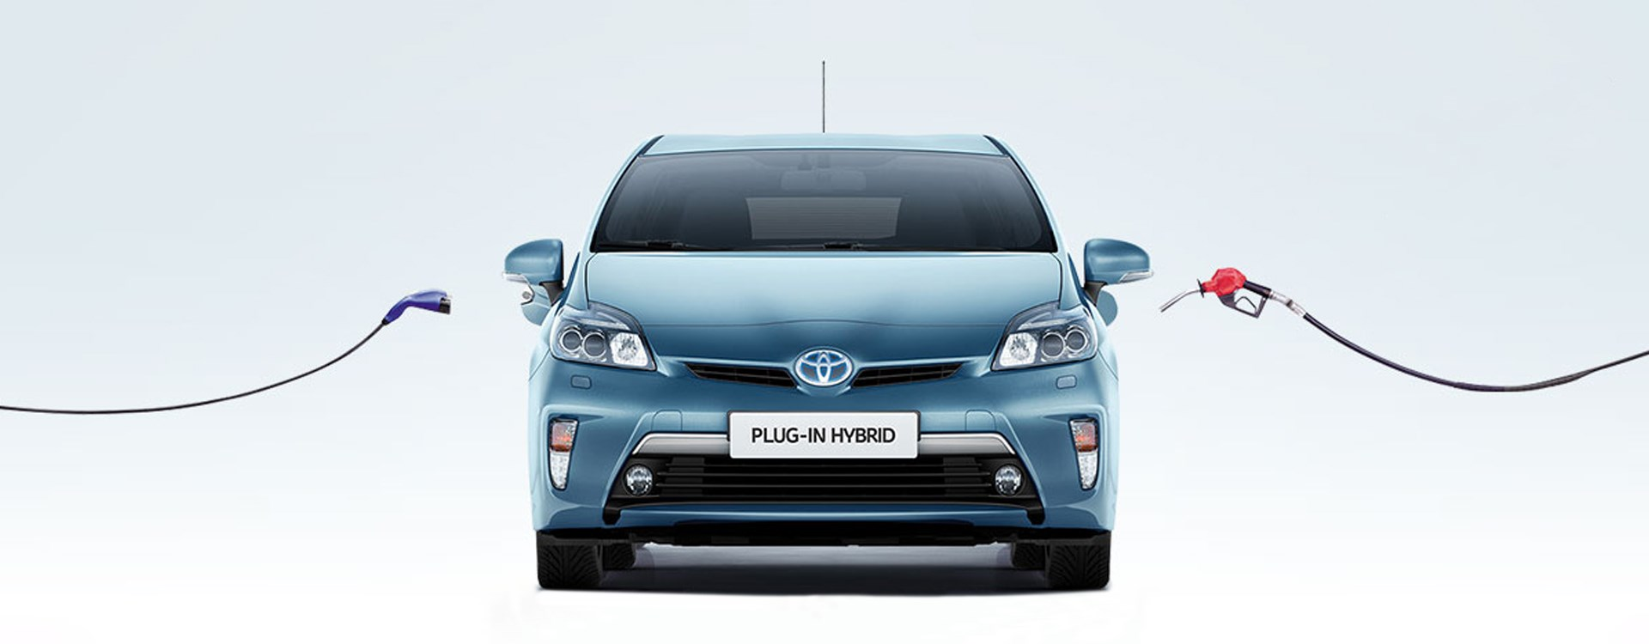
Plug-in Hybrid Electric Vehicles (PHEVs):
Rather than relying solely on an electric motor, plug-in hybrid electric vehicles offer a mixture of battery and petrol (or diesel) power. This makes them better for travelling long distances as you can switch to traditional fuels rather than having to find charge points to top up the battery.
Disadvantages:
Relatively expensive.
Complex to maintain.
Battery life concerns.

Slide 8
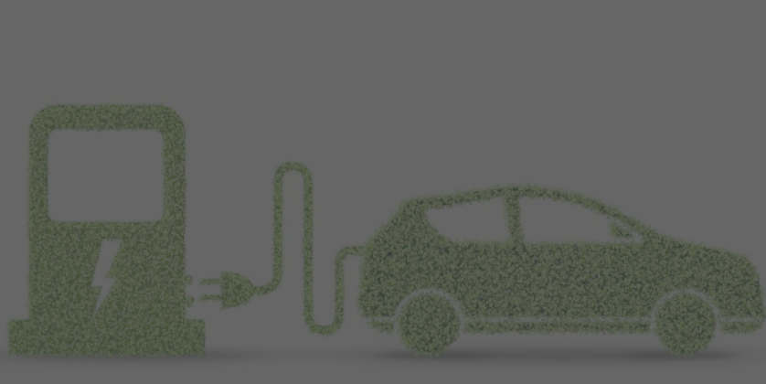
Motivation to embrace EV
Reduce dependency on foregin oil.
Economic growth (energy sources are available locally).
Adopting EVs will help in reducing local air pollution.
Shifting to EVs will reduce Greenhouse Gas (GHG) emissions that gets emitted from running an ICE(Internal combustion engine) vehicle.
If we buy an EV, we will no longer have to worry about the daily fluctuating petrol and diesel prices.
We can generate our own electricity to maximize your electric car savings.
Convenient Charging at Home.
EVs have NO noise of their own!
Low maintenance cost.

Slide 9
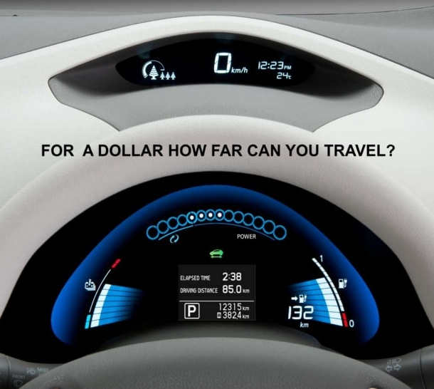
Interesting Facts About EV:
You can drive upto 36 miles i.e, Approximately 58 kms by spending 1$.
Even a low fuel consumption car can drive about 7 kms for a dollar’s worth gasoline.

Slide 10
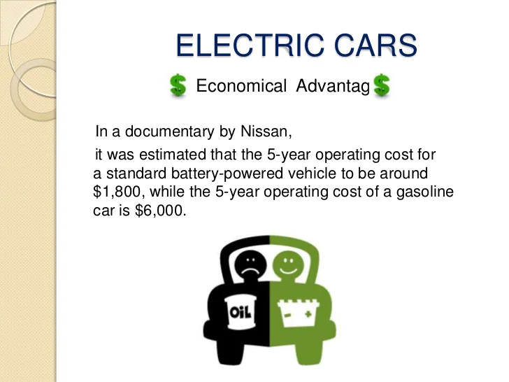
In a documentary by Nissan, it was estimated that the 5-year operating cost for a standard battery-powered vehicle can to be around $1,800 while the 5-year operating cost of a gasoline car is $6,000.
A Tesla Roadster is faster than most sports cars, with an acceleration speed of 0 to 60 kms in 1.9 seconds. To compare, a Ferrari or Lamborghini accelerates from 0 to 62 kms in 2.8 to 2.9 seconds.
Roughly 96% of EV owners would buy or lease another one.

Slide 11
Electric Vs Gasoline
No emissions. | GreenHouse gases/pollution.
100+- Range. | 300+ range.
Hours to recharge. | Minutes to refuel.
Low maintenance cost. | Maintenance cost is pretty high.
2 cents(~2Rs) per mile. | 12+ cents per mile.
Electric cars are limited by range and speed. As of now we can’t use them for long journeys. | They don’t have range limitation.

Slide 12
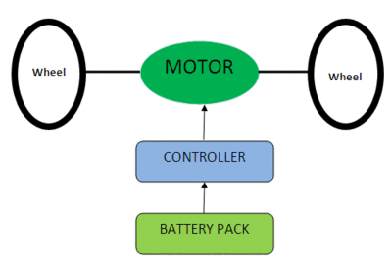
Parts of Electric Vehicles:
Electric Vehicle has three main parts:
Battery
Controller
Motor
Battery: Main source of energy.
Controller: The electric vehicle controller is the electronics package that operates between the batteries and the motor to control the electric vehicle's speed and acceleration.
Motor: Electrical energy is supplied to the motor via the car's battery. The motor in turn converts the electrical energy to the mechanical energy.

Slide 13
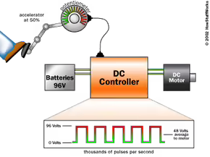
How does it work.?
When the pedal is pushed:
The controller gathers energy from the battery.
Controller delivers appropriate amount of electrical energy to the motor.
Electrical energy transformed into mechanical energy.
Wheels turn and vehicle moves.

Slide 14
Charging methods for electric vehicles.
There are a number of different ways to charge your electric car’s battery pack.
Essentially, it comes down to two main considerations: WHERE you decide to charge and HOW FAST you decide to charge. These are interconnected, and the charging speed will depend on which particular EV you own, its battery capacity and what sort of charging system you are using.
There are three categories or types of charging:
Trickle charge.
AC Charge.
DC charge.

Slide 15
TRICKLE CHARGE:
The slowest method of charging your EV at home, using a standard (three-prong) 220V plug.
Doesn’t require installation of additional charging equipment.
Can deliver 13 to 16 km of range per hour of charging.
Charging speed: approx. 65 km of range in 5 hours (overnight), or 200 km in 14 hours.
It is only recommended in urgent cases, with caution and consultation with electricity providers.
Using Trickle Charge is only recommended in urgent cases when you have low battery charge and cannot drive to a public station or access an AC wallbox at home. This is because the use of household electricity may cause problems associated with electricity bills and electrical loads.

Slide 16

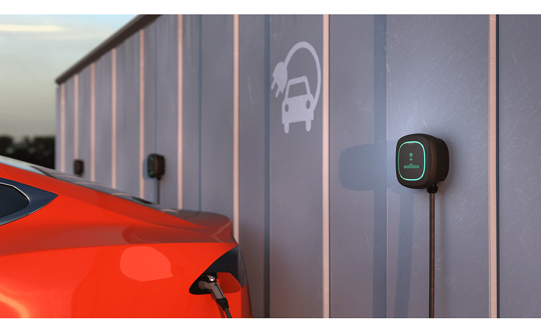
AC CHARGE:
Requires the installation of a dedicated EV charging wallbox, which should be fitted by a trained electrician.
It is the most common and recommendable home charging option.
Provides charging through a 230V outlet which allows charging 3 to 4 times faster than Trickle Charge – depending on the acceptance rate of your specific model and the charger.
Especially useful if you have time to top up your electric vehicle overnight: it takes around 6 hours to fully charge a 40 kWh battery car.

Slide 17
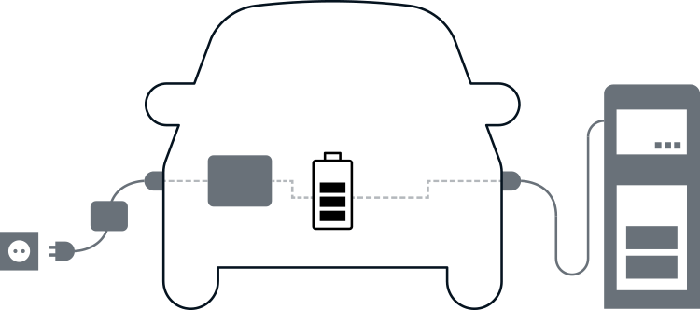
DC CHARGE:
The fastest way to charge your EV – at a public DC Fast charging station with power from 50 kW and above.
With this method you can top up your battery from 20 to 80% in approx. 40 minutes.
There are also some ultra-fast charging stations that already provide more than 150kW.
It is currently the quickest way to charge an electric vehicle.

Slide 18


